Slide 1
MLS-MPM-CPIC
Review By:
Daniel Palomino

Slide 2
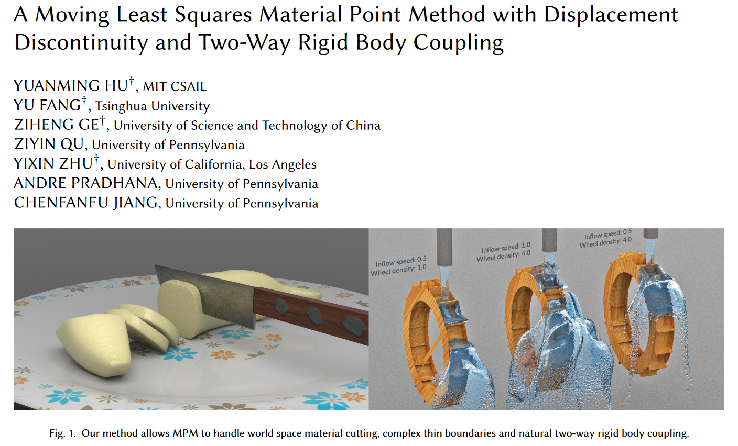
Paper to work

Slide 3
Glossary
MLS: Moving Least Square
MPM: Material Point Method
CPIC: Compatible Particle-In-Cell

Slide 4
Advantages
Two times faster tan before.
Sopport of new phenomena:
-Material Cutting.
-Dynamic Open Boundaries.
-Two-way coupling with rigid bodies.

Slide 5
From MPM to MLS-MPM
Particles to Grid: Use APIC or PolyPIC to transfer mass and momentum from particles to grid.
Update grid momentum: Use either symplectic Euler backward Euler to update grid momentum.
Grid to particles: Use APIC or PolyAPIC to transfer velocities and affine/polynomail coefficienets from the grid to the particles.
Particle deformation gradient: Update particle deformation gradient using the MLS approximation to the velocity gradient.
Update particles plasticity: Project particle deformation gradient for plasticity.
Particle advection: Particle positions are updated with their new velocities.

Slide 6
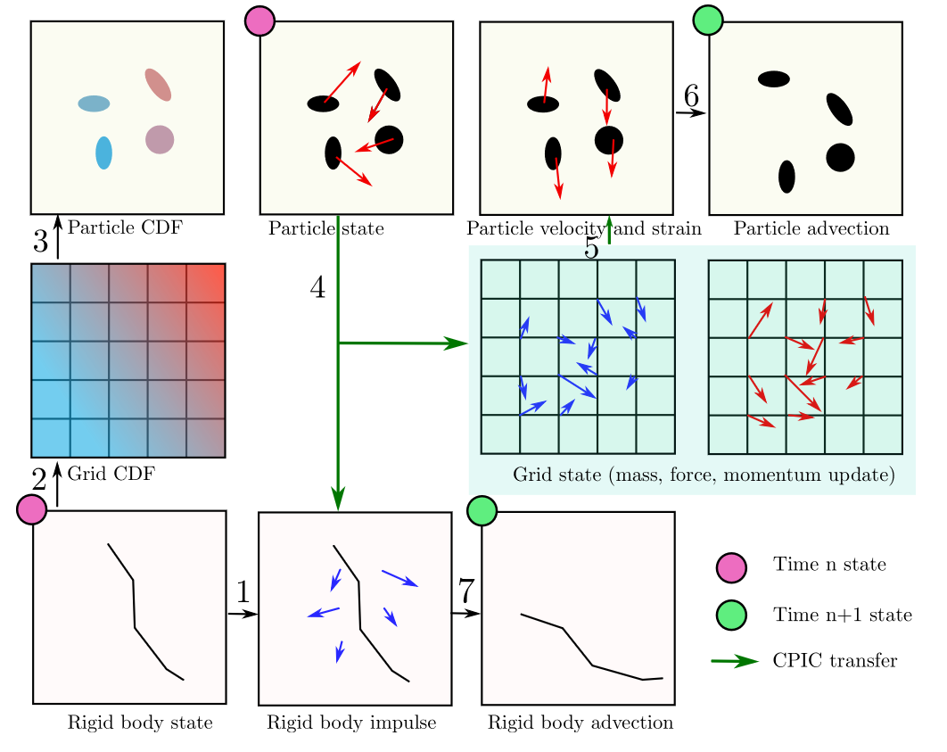
MLS-MPM (Graphic)

Slide 7
DIFFERENCES
The only difference between MLS-MPM and traditional MPM are the force in step 2 (Update grid momentum) and the F update in step 4 (Particle deformation gradient).

Slide 8
HIGH PERFORMANCE IMPLEMENTATION
Performance Engineering: Low level performance optimización to accelerate the program with no algorithmic change.
Algorithmic Improvement: The Unification of affine velocity field and deformation gradient speeds up both P2G and G2P.

Slide 9
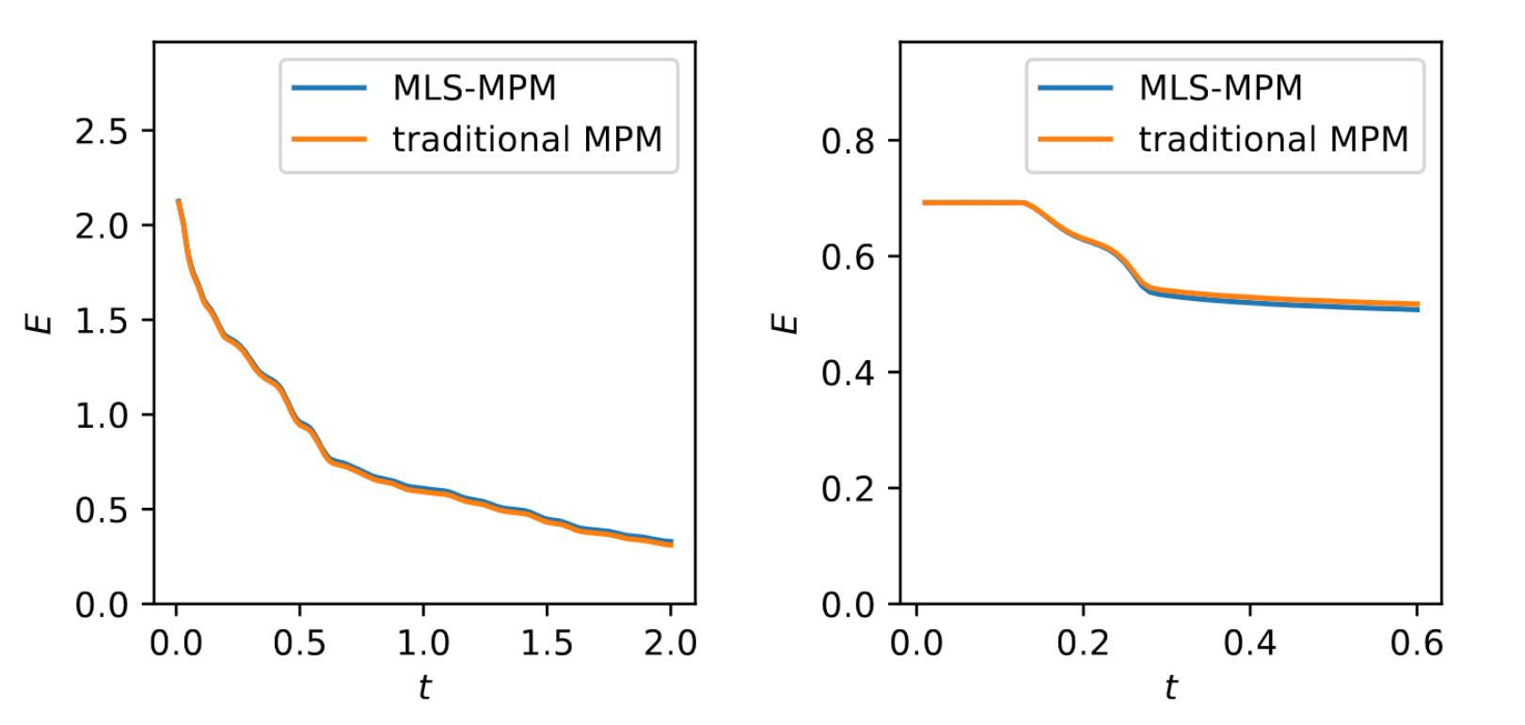
Benchmark
Total energy evolution curves from MPM and MLS-MPM in the oscilating jello (left) and colliding balls (right) test cases. Numerical dissipation from two method are nearly identical.

Slide 10
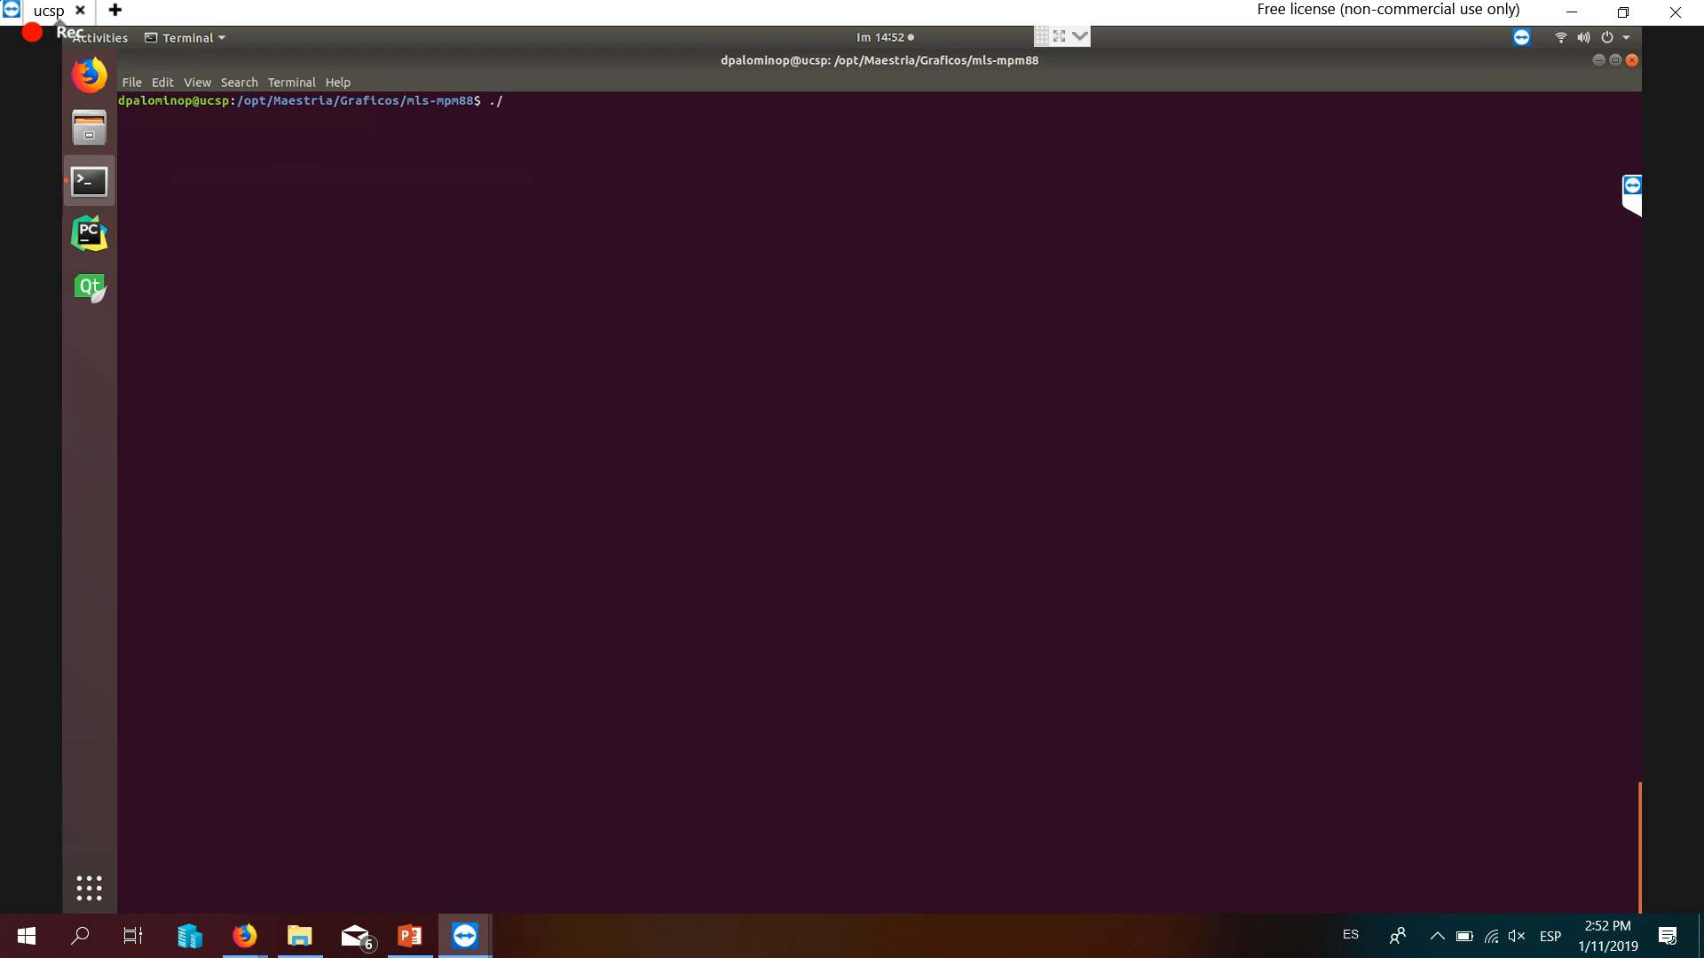
Demo 01 - Blocks

Slide 11
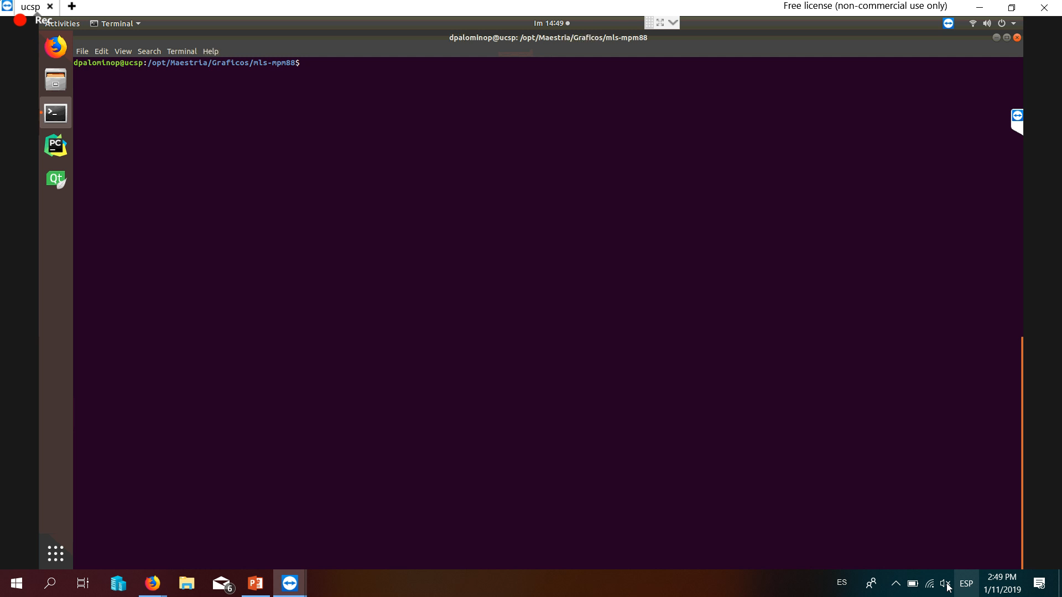
Demo 02 - Tetris

Slide 12
Thanks

